Slide 1
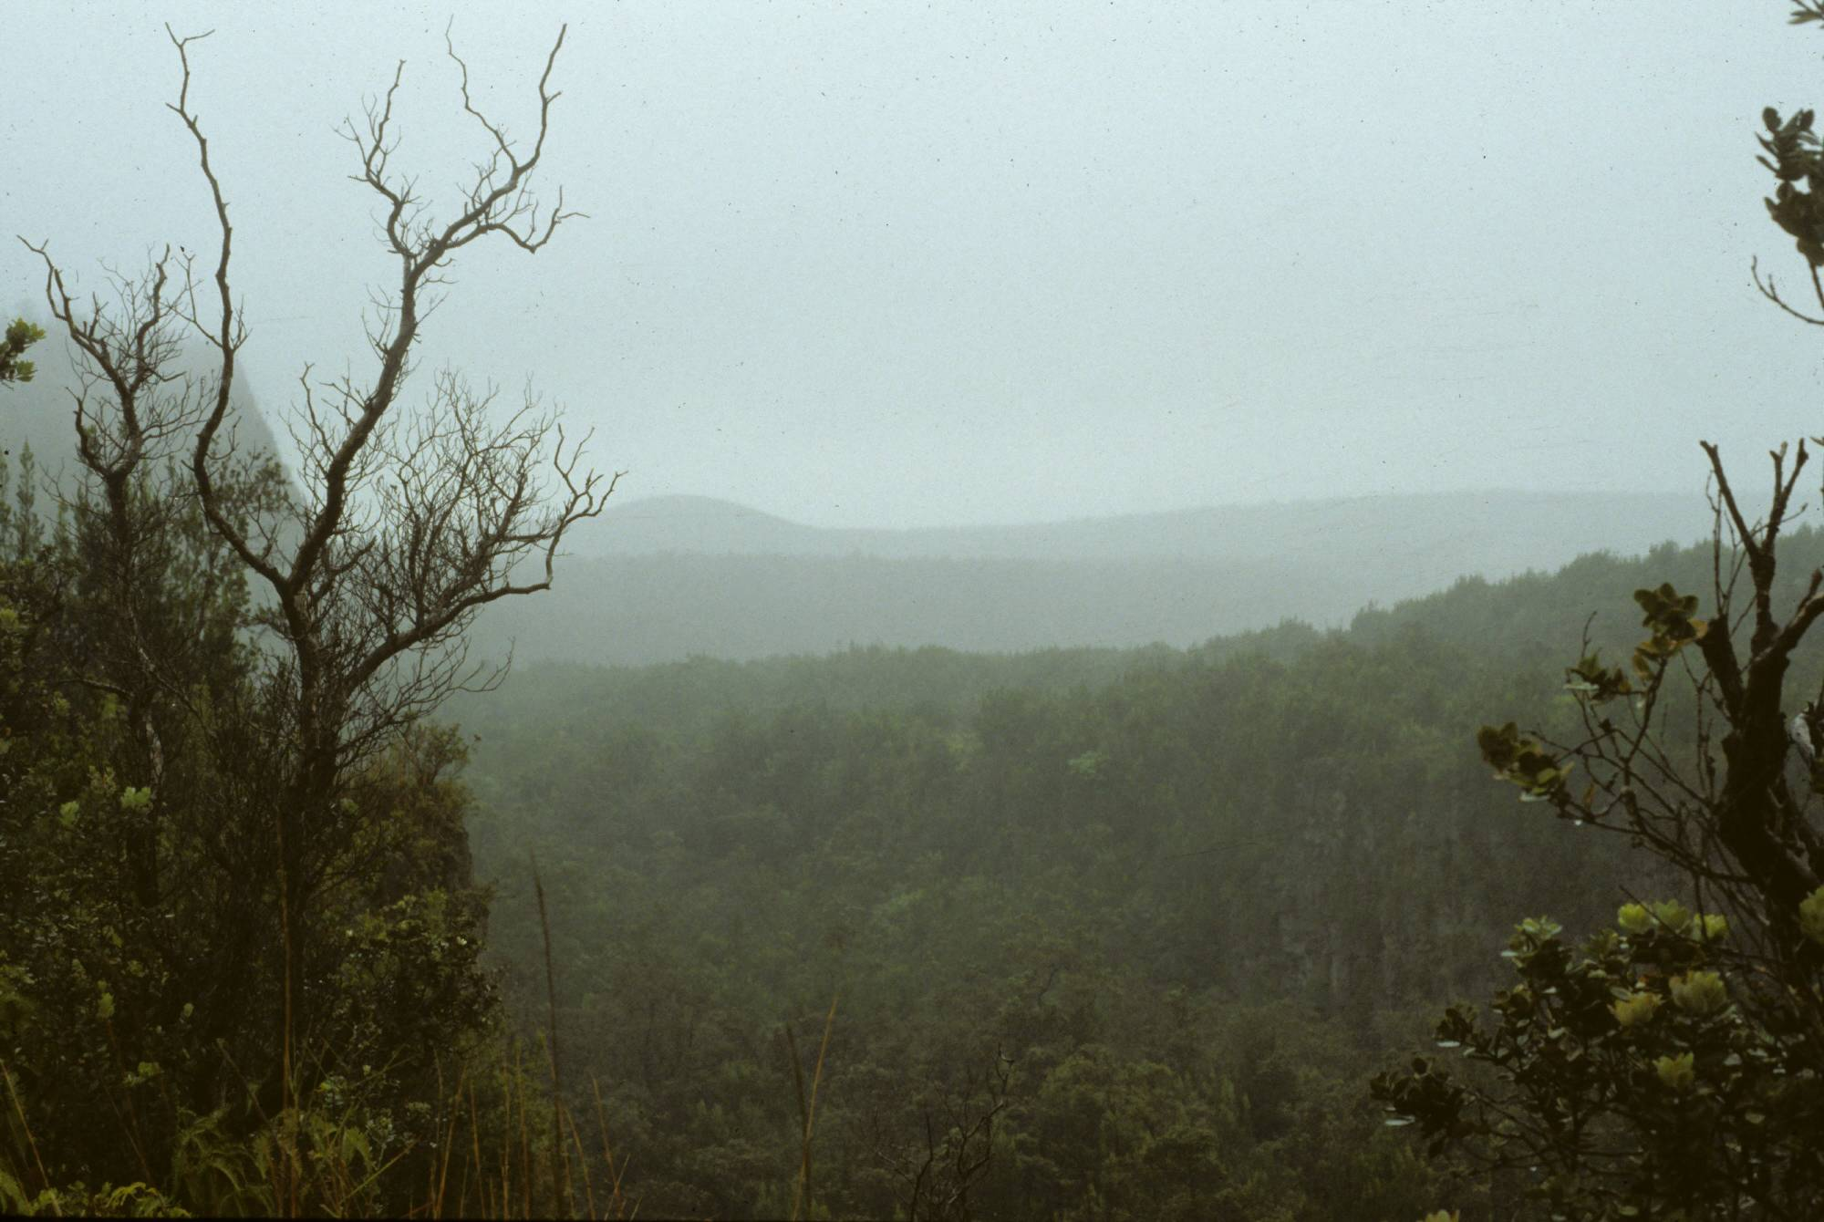
The Role of Disease
Naïve populations, disease vectors, adaptation and ecological change due to disease.

Slide 2
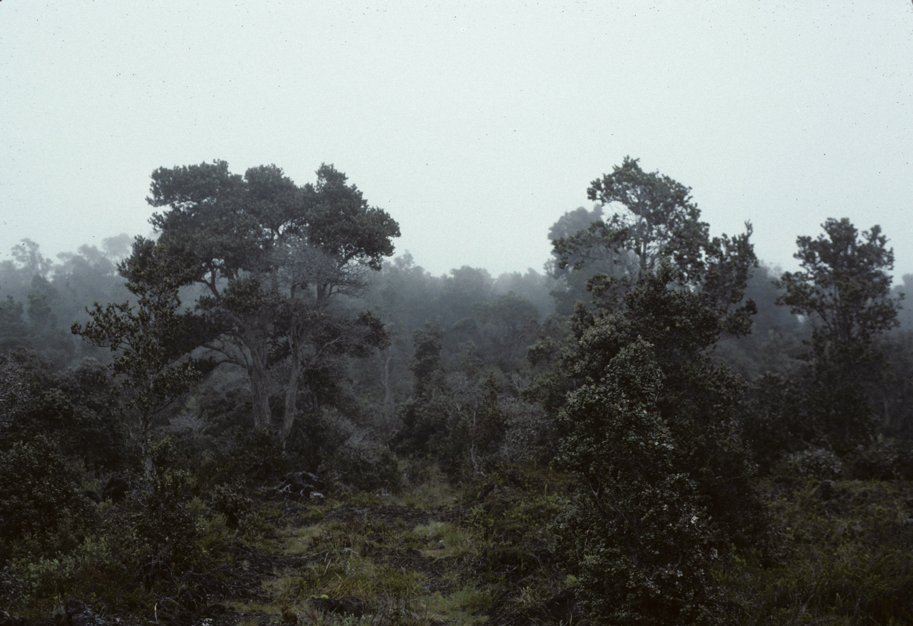
Excerpt from: Forest Birds of the Hawaiian Islands
The Hawaiian Islands, located more than 4,000 km from the nearest continent and 3,000 km north of the Marquesas, are the world’s most isolated group of islands. As a result, the Hawaiian flora and fauna, derived from a relatively small number of colonists, have a high degree of endemism and are rather vulnerable to disturbance. Many species, notably the Hawaiian honeycreepers … offer outstanding examples of adaptive radiation. The stimulating evolutionary insights provided by Hawaiian plants and animals are tempered by the bleak prospects for their continued survival.

Slide 3
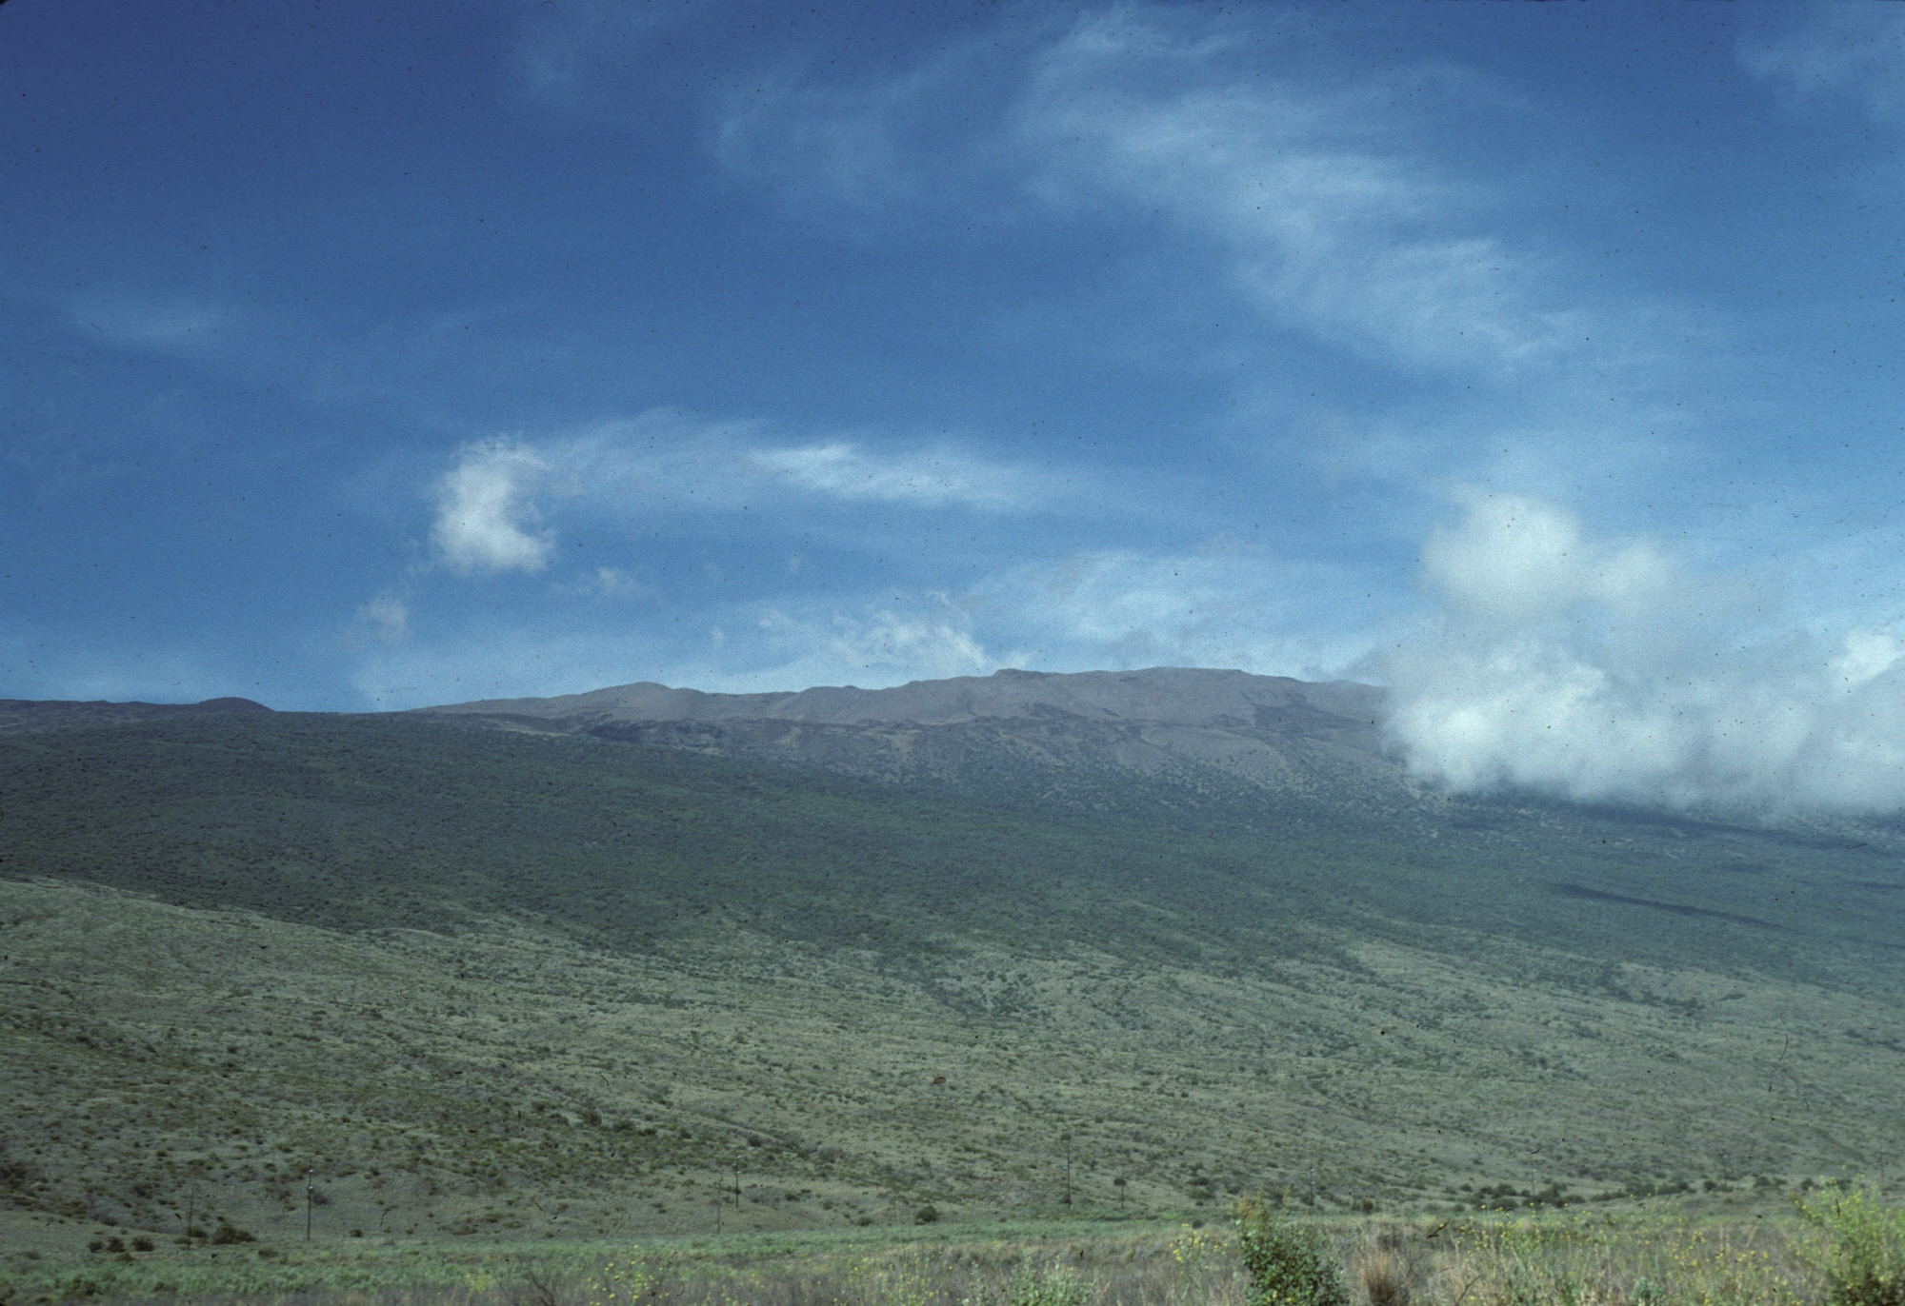
Objectives
Examine the role of disease in impacting naïve populations and the role of vectors in disease transmission to these populations.
Consider the differences between plants and animals when encountering diseases.
Examine adaptations and ecological changes that occur in the presence of disease.

Slide 4
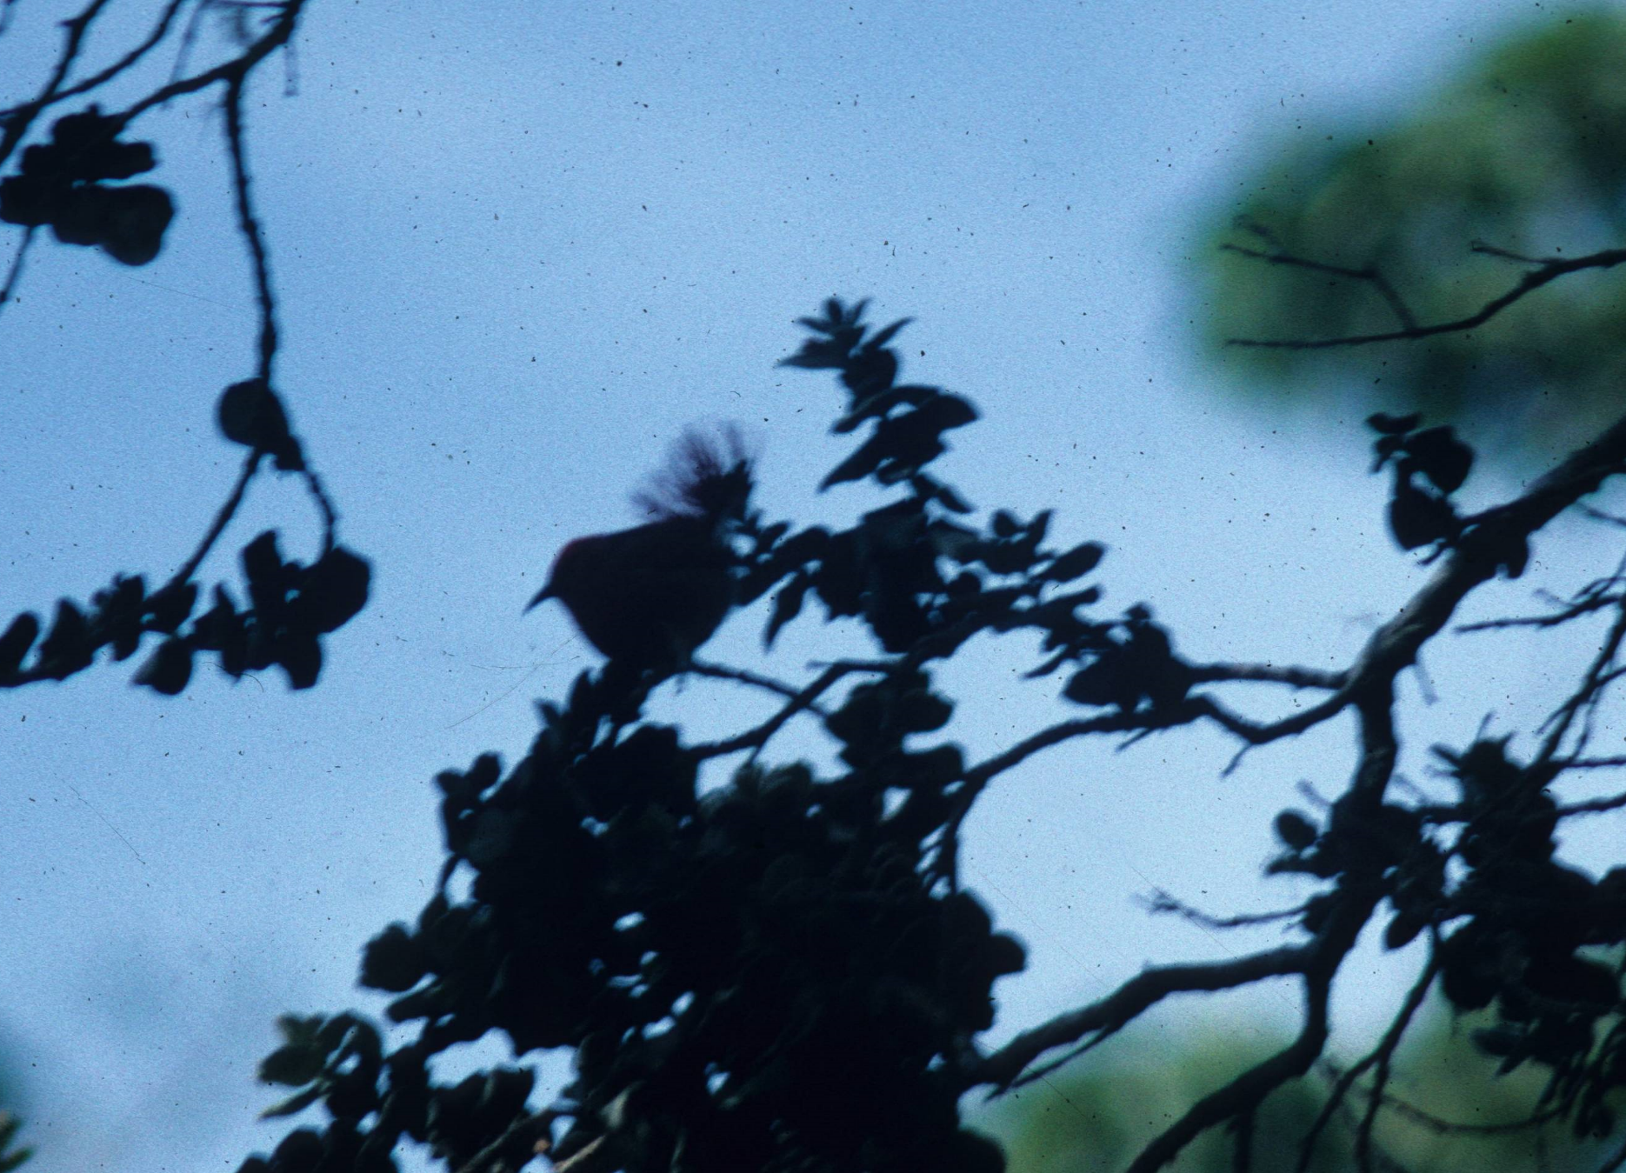
Naïve Populations and Imported Disease
When I visited Hawaii Volcanoes National Park in 1992, the rainforests rang with the songs of birds. However, upon closer inspection, I discovered that all of the songs came from a single species- the Apapane. Slide 1 shows this location.
By then, over half of the original Hawaiian avifauna was extinct, and those species remaining occupied only a portion of their original range- primarily the rainforests shown in slide 2.
Rainforest occurs in a belt, shown in slide 3, at high elevations where water condenses from clouds when rising over the island’s mountains.
These mass and rapid extinctions occurred due to a combination of exotic plant and animal introductions, habitat destruction and, most catastrophically, introduced disease.
One of the surviving Hawaiian honeycreepers, the Apapane, feeding from flowers of the endemic Ohia tree.
Even by the time of Western contact, however, native Hawaiians had already driven over 40 species to extinction- a pattern typical for human arrival on islands.
Native Hawaiian birds had evolved in the absence of diseases, so had no immunity to them.

Slide 5
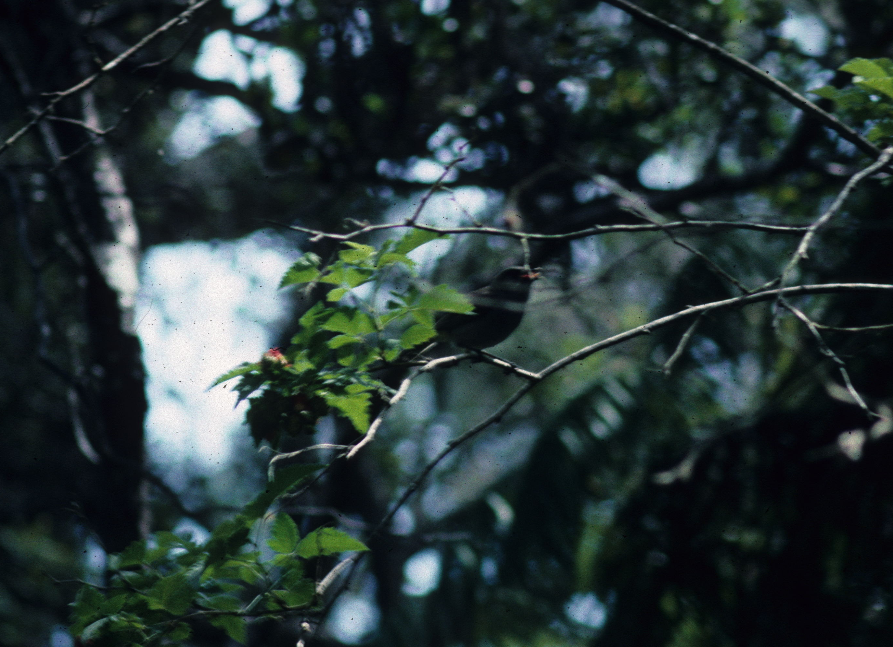
Disease Vectors
Disease arrived with mosquitos, reportedly introduced to the islands via ballast water on ships. There were no native Hawaiian mosquitos.
The first arrived in 1826, and these were able to transmit avian pox, a virus that appears to have arrived on exotic birds brought to the islands.
Other mosquito species followed, and by the early 1900s avian malaria arrived. By the 1930s, some bird species common in the 1890s had become extinct and populations of others had receded to the highest elevations.
The spread of mosquito-borne diseases is limited by the cold temperatures of high elevations, which makes them inhospitable for tropical mosquitos. Hence, native birds avoid disease at these elevations.
However, mosquitos are ranging higher into mountains as they adapt to their new environment. As they do, they bring disease with them.
The Omao is the last species of Hawaiian thrush with a viable population.
Since Western contact, 20 more species and subspecies have become extinct and another 31 have become endangered.

Slide 6
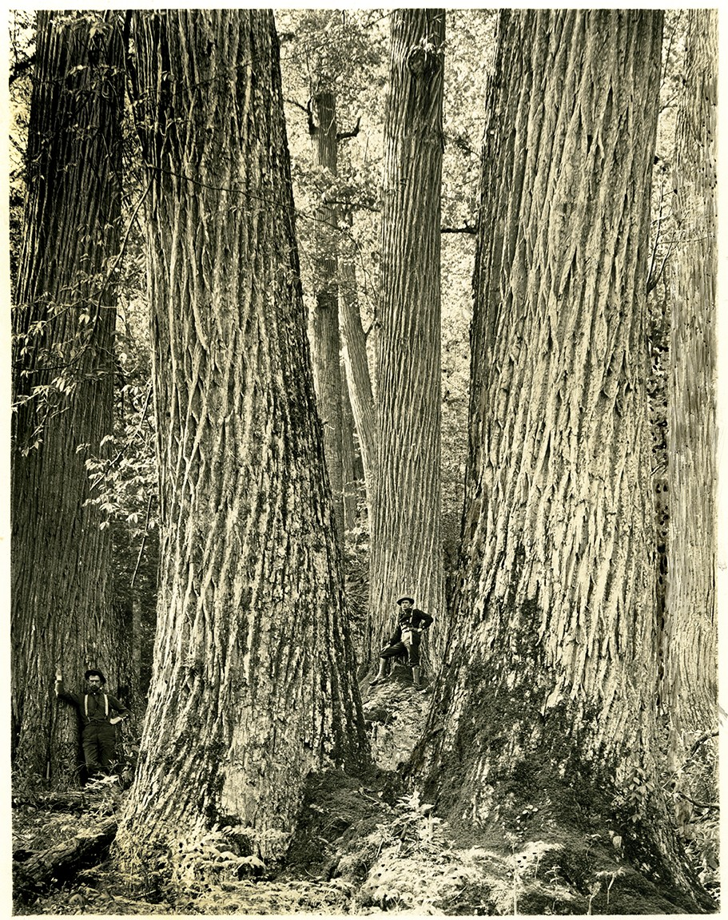
Naïve Plant Populations
Vulnerability to introduced disease is not limited to island populations or to animals.
In 1900, American Chestnut was one of the most abundant Eastern forest species, with an estimated population of 3.5 billion.
It can be described as a keystone species, exerting a major influence on the forest community. Unlike oaks, American Chestnut produced a large crop of nuts each year and was a major food for a variety of wildlife species.
Loss of the species has been implicated in the extinction of 7 moth species, drastically reduced squirrel populations, slowed recovery of wildlife populations such as those of deer, reduction in numbers of cavity-nesting birds and decrease in river water quality.
In 1904, Chestnut Blight, a fungal disease, was accidentally introduced into New York City on imported Japanese Chestnut trees- a disease to which the native species had no resistance.
The disease spread 50 miles/ year, and by 1940 the species was functionally extinct throughout its native range.
Old growth American Chestnut- one of the largest, fastest growing species of the Eastern deciduous forest.

Slide 7
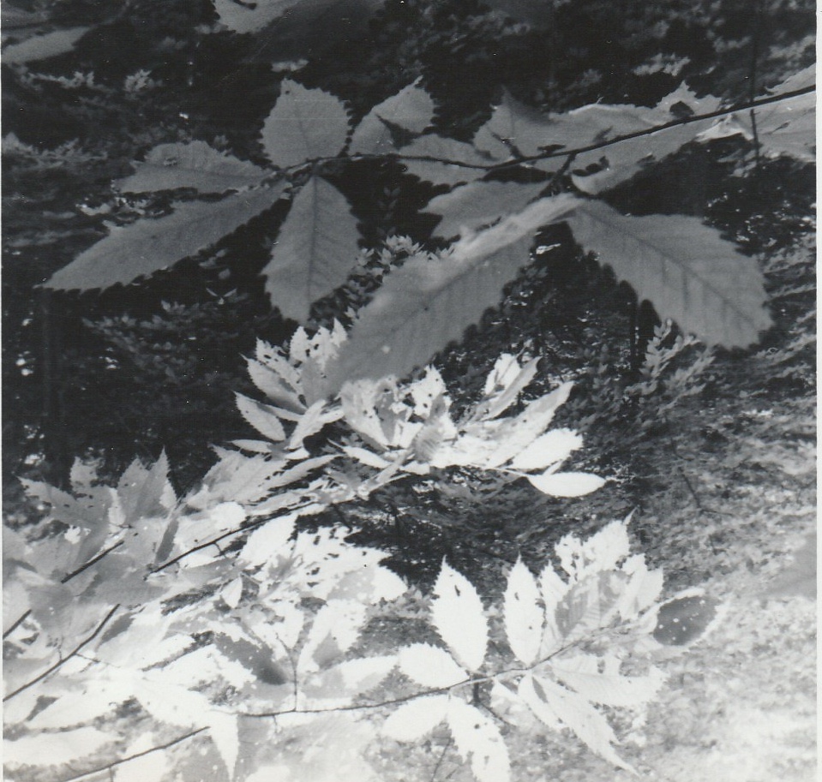
Conservation Efforts
Because of its economic value, efforts aimed at breeding resistant trees began early, with the Connecticut Agricultural Experiment Station beginning experiments to hybridize American with resistant species of chestnuts by 1930.
By using backcrossing, where a resistant hybrid is crossed back with American Chestnut, trees with 15/16 American genes are selected within several generations. Such backcrossed hybrids are now being planted.
A new procedure using genetic engineering to insert only blight resistant genes is now underway at the State University of New York. A gene from wheat for production of oxalic oxidase, which breaks down oxalic acid produced by the fungus gives complete resistance. These transgenic individuals should be available to the public within several years.
Because of the species’ diverse gene pool that persists in sprouts that continue to grow from old stumps, it is likely that given enough time, natural resistance will emerge. Evidence for this is that the size of sprouts has increased over time.
1970 photograph of a sprout American Chestnut growing from the remains of an early 20th century stump.

Slide 8
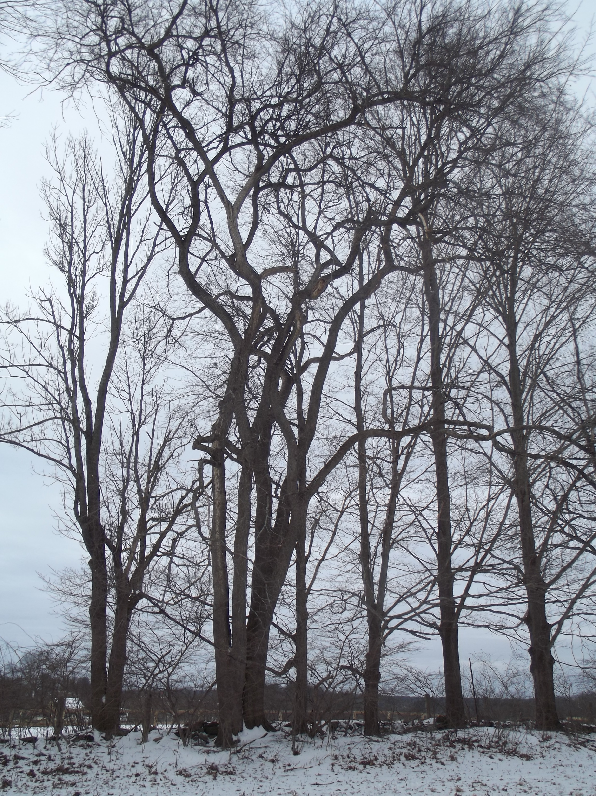
Disease-Insect Synergy
Insects are often the vectors for entry of disease in both plants and animals. This is the case with the demise of the American Elm.
The Asian-originated Dutch Elm Disease reached North American on infected lumber in 1928, although an even more virulent species arrived in the 1940s.
This fungal disease is spread by 3 species of Elm Bark Beetle. The beetles burrow into the bark and when travelling from an infected to an uninfected tree, they spread the fungus.
The disease is also spread between trees that have roots grown together.
Of an estimated 77 million elms, over 75% are now gone. However, as with the chestnut, trees produce enormous numbers of seeds that grow vigorously in especially mesic habitats.
There are examples from the pollen record that apparently disease-related contractions and re-expansions of range occurred in pre-history, notably the decline of elm in Europe 6,000 year ago.
Hence, there is evidence that species can evolve resistance to catastrophic disease events.
An untreated, mature American Elm, exhibiting its characteristic vase shape, is now an uncommon sight.

Slide 9
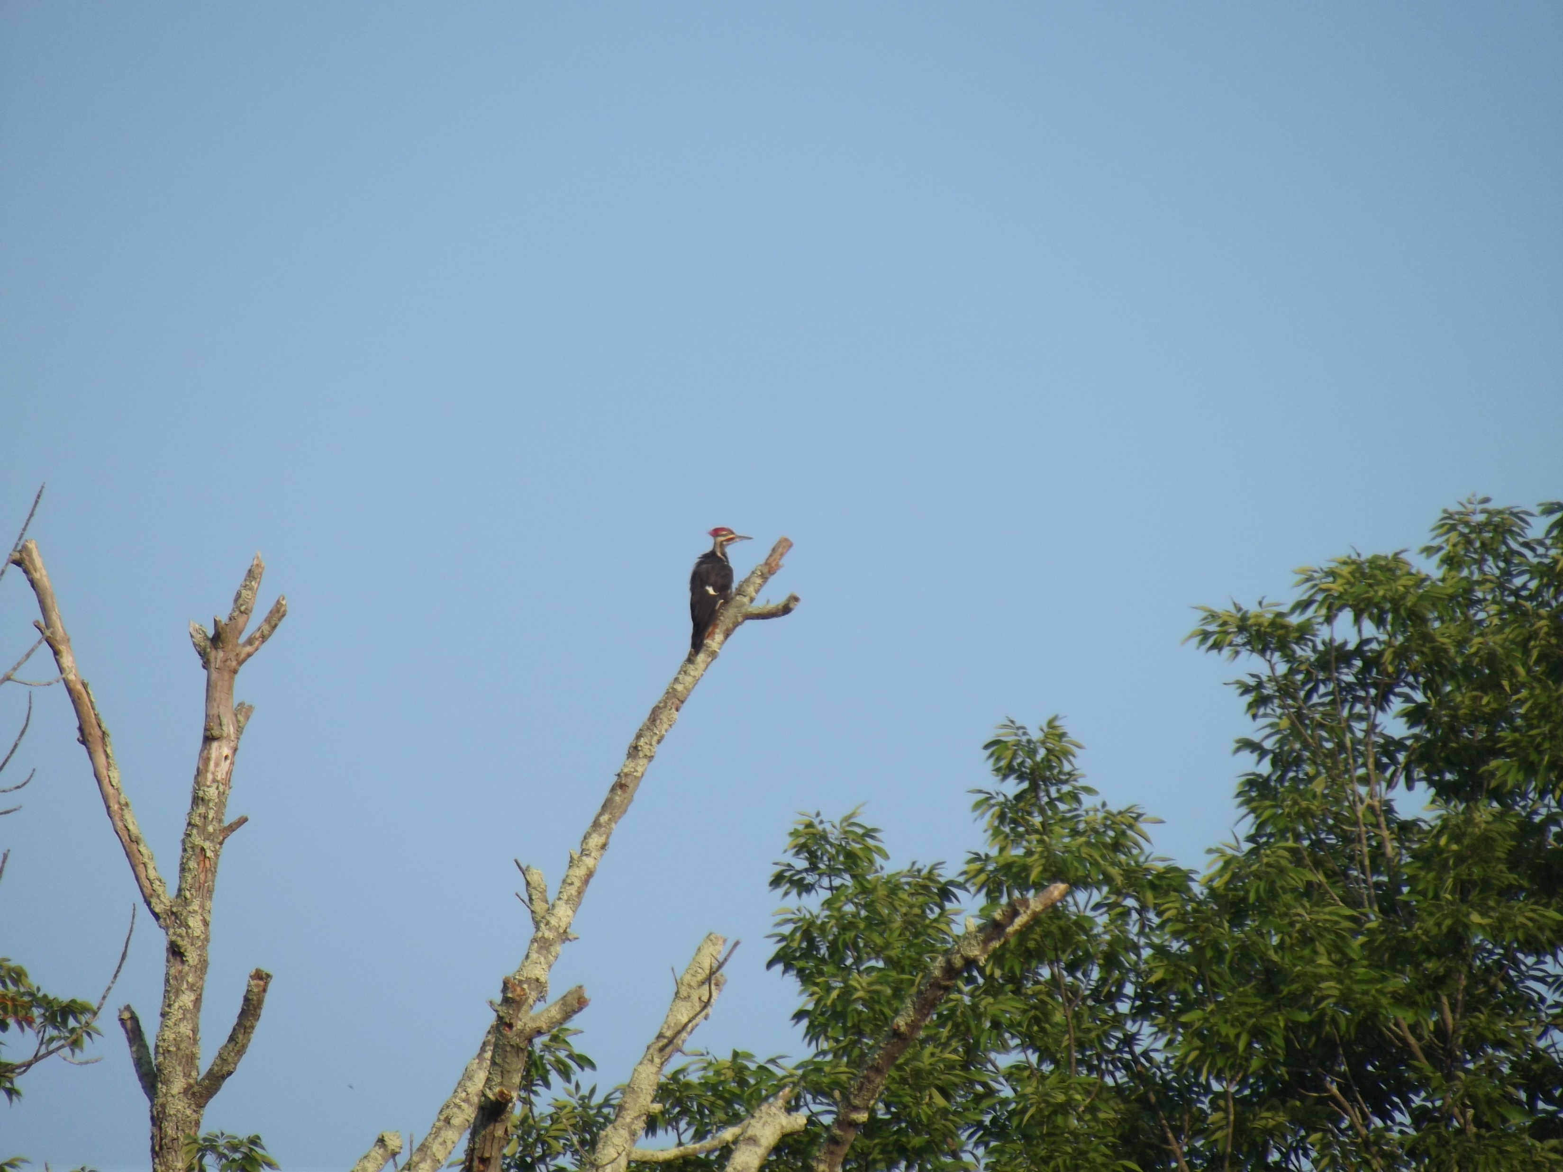
Emerging Threats
The White Ash is another common and widespread tree that is experiencing catastrophic decline. Hundreds of millions of trees of a population estimated at 7.5 billion are already estimated to have been killed.
Multiple causes of the decline are affecting the species. Diseases include Ash Decline, associated with fungi, viruses, nematodes and Phytoplasma that combine to kill trees, and Yellows, caused by Phytoplasma and spread by leafhoppers and spittlebugs.
Emerald Ash Borers are also now a serious threat, arriving from Asia in 2002 and now in 35 states and 5 Canadian provinces.
As with the elm and chestnut, because the species still has a huge gene pool and produces enormous numbers of seeds, it is likely that on the time scale of thousands of years the species will adapt to these threats.
The problem is that, on the human time scale, the conservation tragedy is now.
A dead White Ash with its wood-boring insects being fed upon by a Pileated Woodpecker. This tree is adjacent to an infected tree.

Slide 10
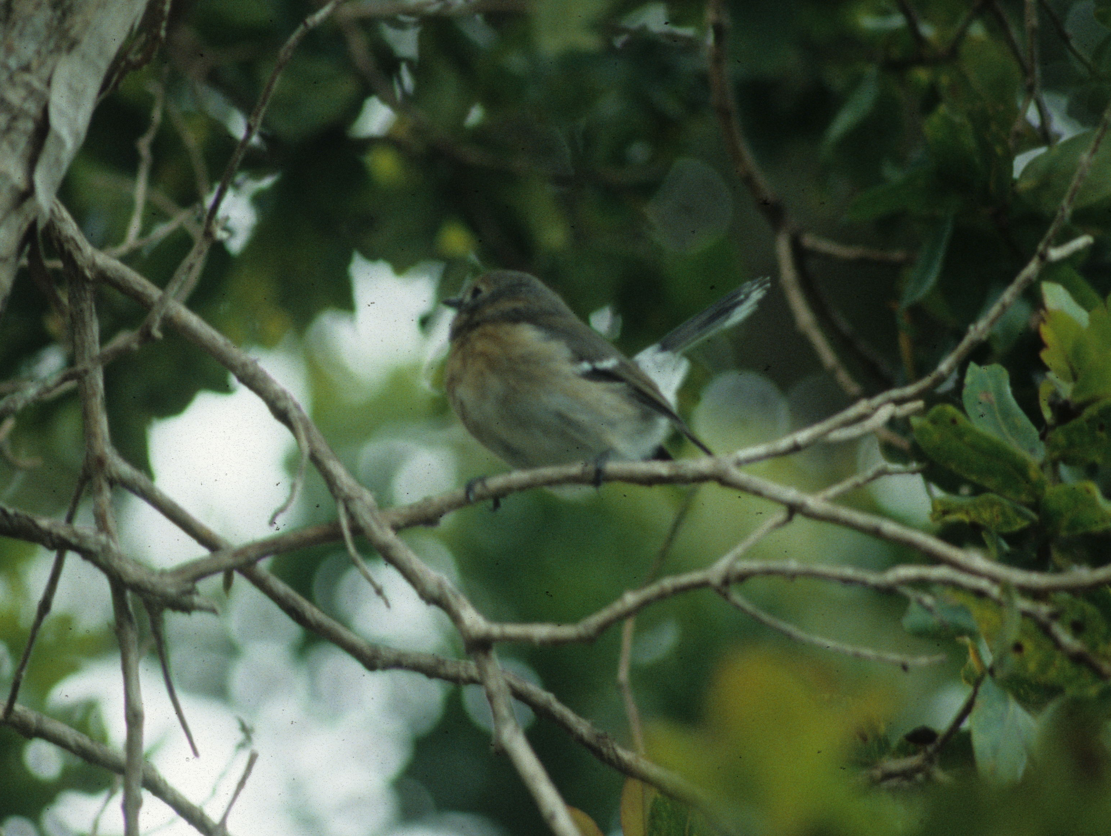
Adaptation vs. Population Decline
With a large gene pool, we may expect that over time key adaptations will appear that will permit the development of disease resistance.
With plant species that produce large numbers of seeds or that can sprout from roots, the probability appears great that this adaptation will occur, although likely not within the span of a human life.
However, with animal species that produce small numbers of offspring and that lose much of their gene pool when populations rapidly decline, the probability of developing adaptations is less.
Hence, what has occurred in the Hawaiian Islands is the loss of much of the original bird diversity.
However, some species do appear to have succeeded in adapting to introduced disease, notably the flycatcher relative the Elepaio, which is re-occupying portions of its former range.
Moreover, the lowland honeycreepers the Common and Oahu Amakihis are prospering and genetically different from high elevation populations.
An Elepaio in native Ohia forest.

Slide 11
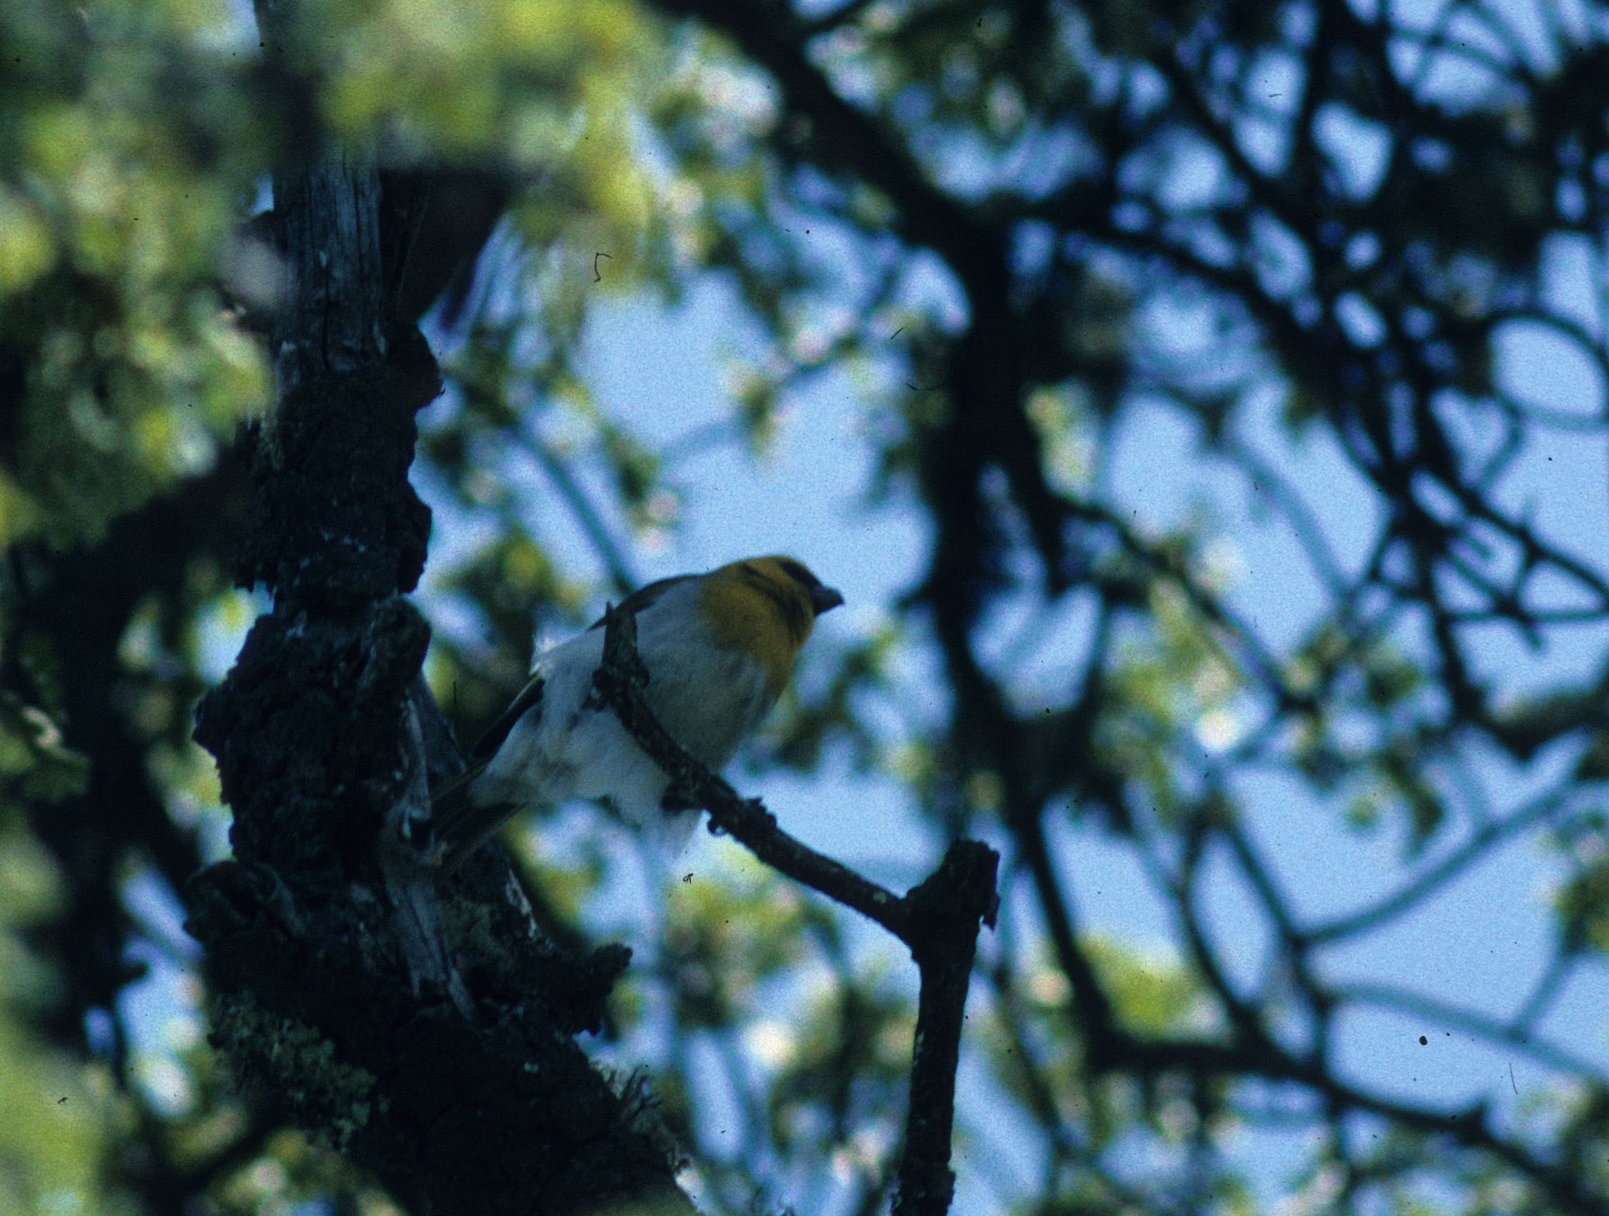
Disease Altering Species Ecology
In contrast to species that have developed resistance to disease, others have had their ecology altered by disease.
Historically, the Palila was once widespread in dry forest, ranging down to 4,000 ft. It is now restricted to Mamane-Naio savannah above 6,500 ft, which is higher than that recorded in the late 19th century.
Prehistorically, fossil evidence demonstrates that it ranged down to sea level.
It now feeds largely on the seeds of the Mamane tree, although it also eats Naio fruits and caterpillars.
It appears that prehistoric populations ranged across a wider range of dry forests and likely had a wider diet.
Hence, its ecology has shifted in the face of disease and habitat destruction.
A Palila perched in a Mamane tree in the high elevation dry savannah of Mauna Kea.

Slide 12
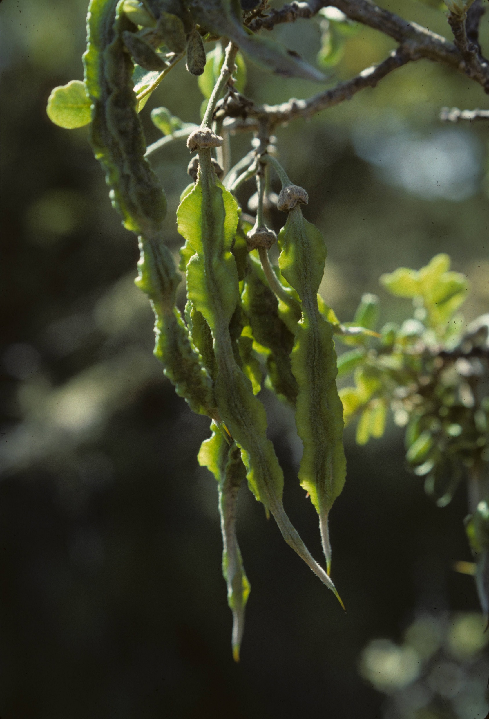
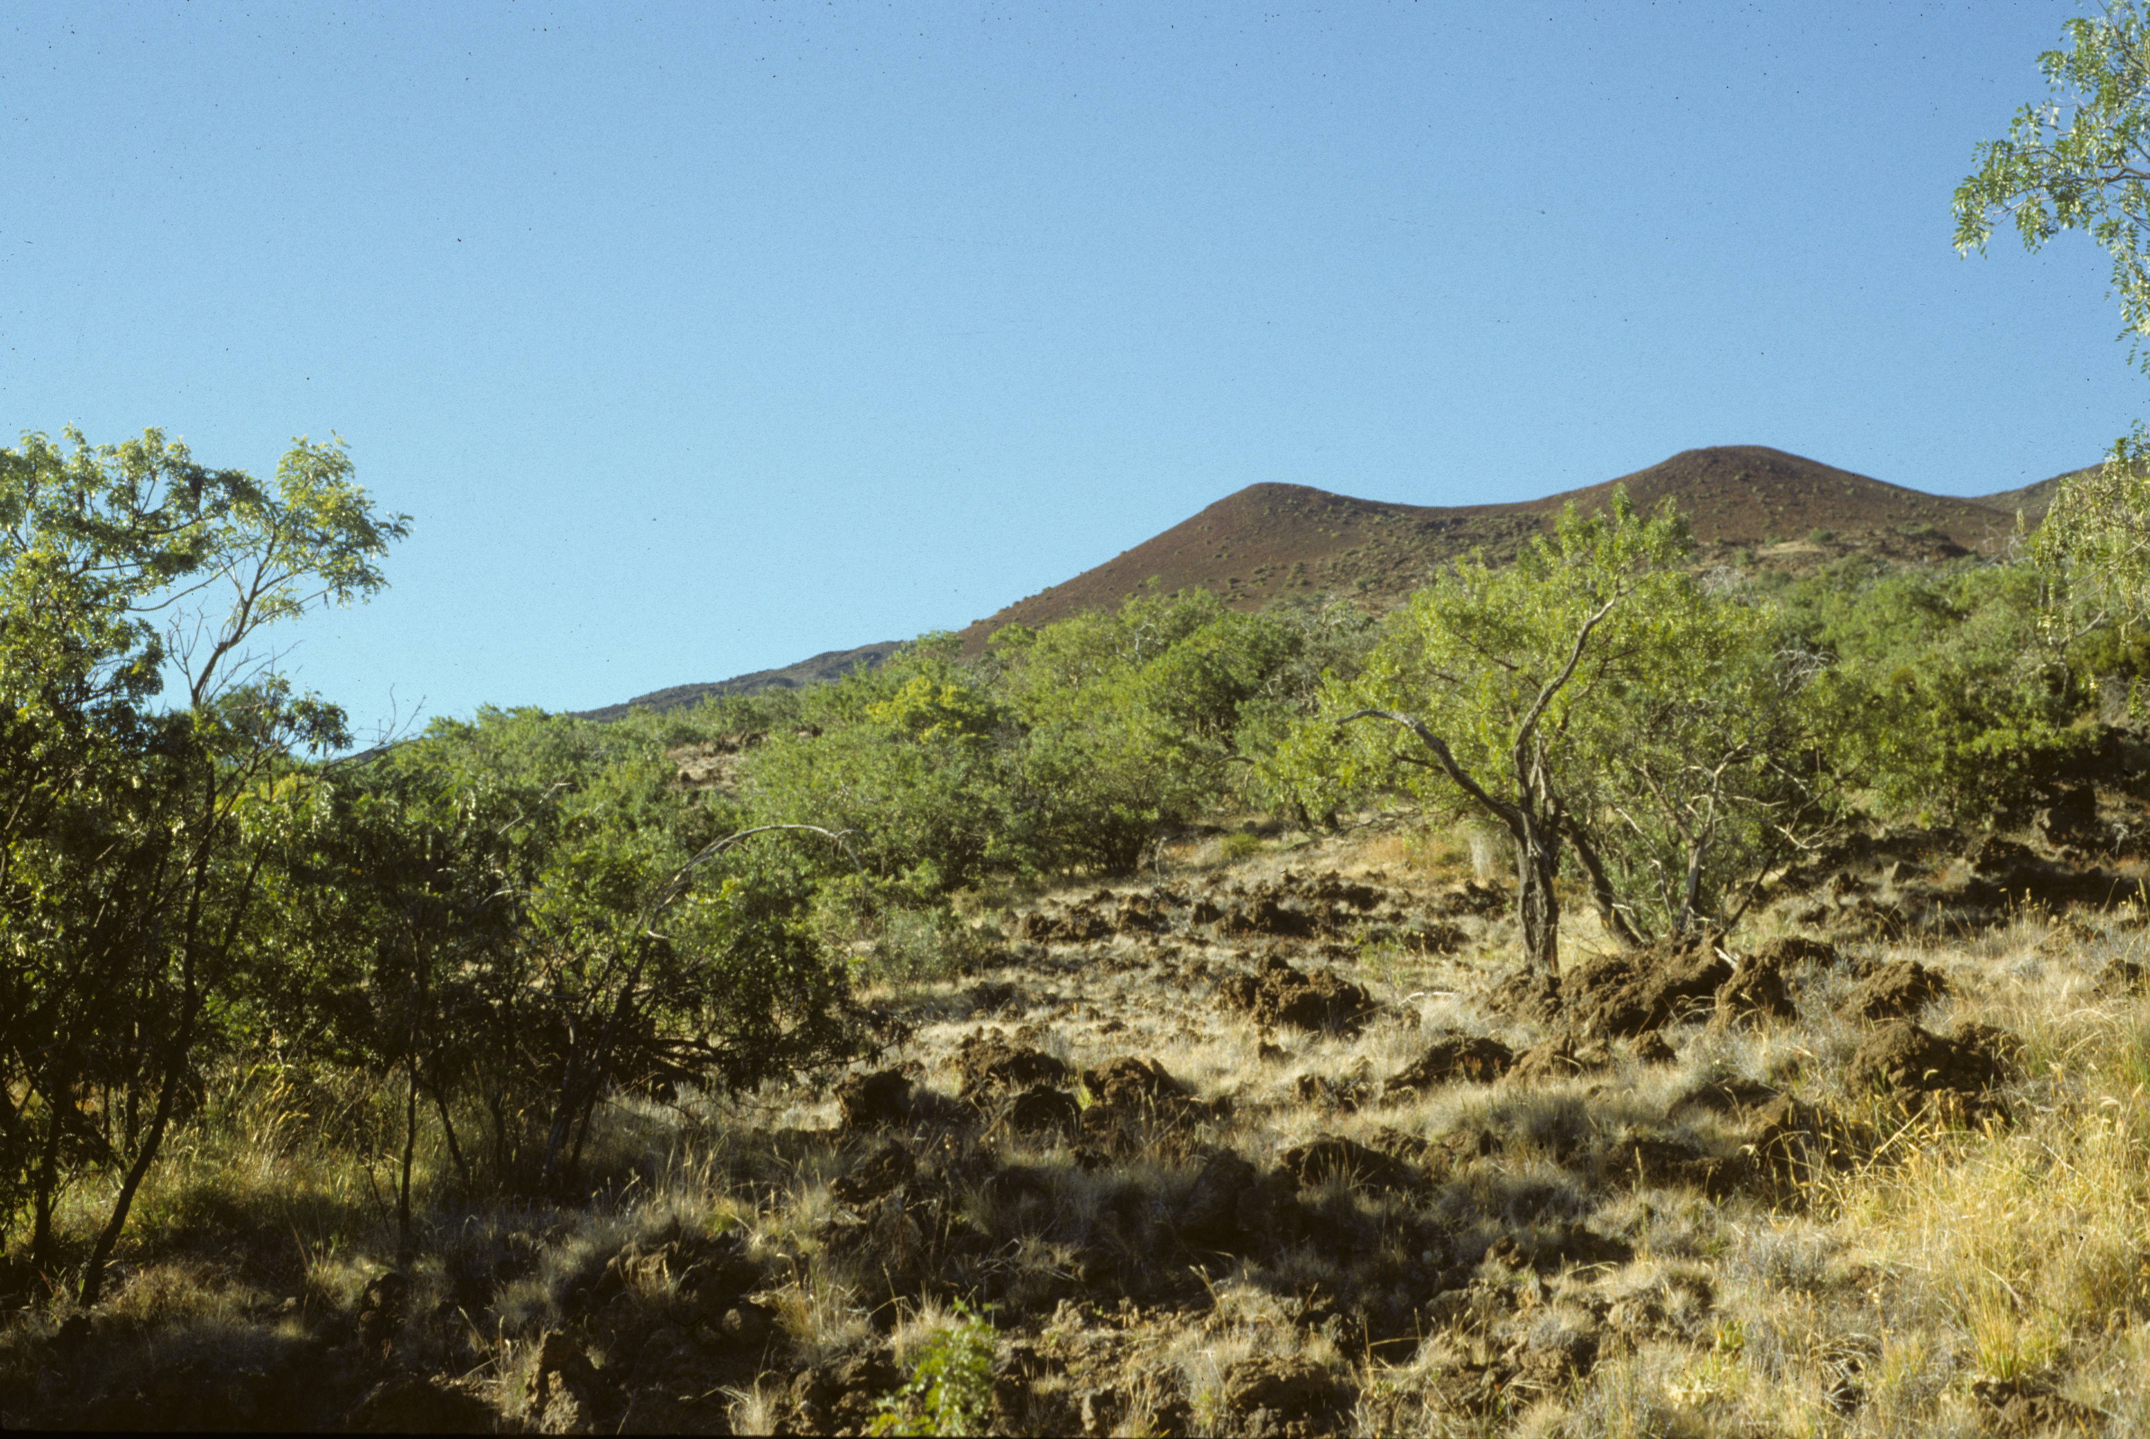
Seed pods of the Mamane
High elevation Mamane-Naio savannah of Mauna Kea

